Slide 1
Web Development in Microsoft Visual Studio

Slide 2
Lecture Overview
Introduce Visual Studio
Create a first ASP.NET application

Slide 3
Introduction to Visual Studio 2012
All ASP.NET development and testing can take place inside of Visual Studio 2013
A local Web server is provided for testing purposes
It’s part of Visual Studio 2013
Intellisense works for server code and JavaScript, XHTML, and HTML5
It works similarly to what you saw in IS350 and IS360

Slide 4
Visual Studio Windows
The Toolbox contains HTML controls and ASP.NET controls
Drag control instances using Design or Source view
The Solution Explorer lists the application’s files
The Properties window is used to set object properties
Other windows work as you would expect

Slide 5
Creating an ASP.NET Application (Web Site)
You create a Web site in much the same way as you create a desktop project
Click File / New / Web Site
In the New Web Site dialog box
Select ASP.NET Web site
Select the desired folder (The folder should be empty or not already exist)
Note that different framework versions are supported

Slide 6
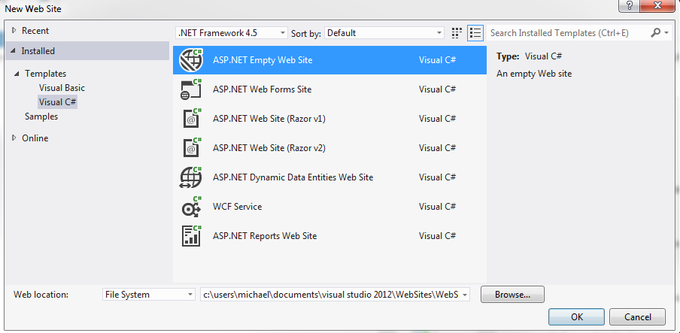
New Web Site Dialog Box (Illustration)

Slide 7
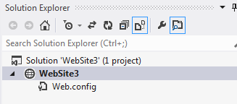
Solution Explorer Files (1)
Web forms (.aspx) make up the visual forms
They are HTML5 documents
There is a code behind file (.aspx.cs)
Web.config contains configuration information
It’s an XML document

Slide 8
Solution Explorer Files (2)
If you select a Web Forms site,
Jquery is included in the default template in the folder Scripts
Site.master contains the application menu
Styles contain cascading style sheets (.css)

Slide 9
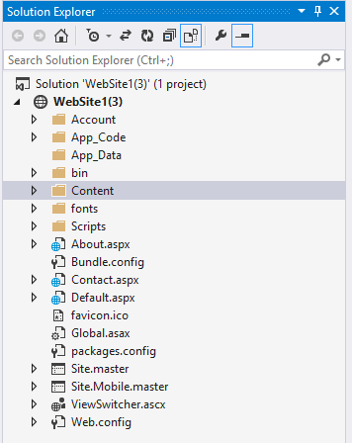
Solution Explorer Files (Illustration)

Slide 10
Parts of the Designer Surface
Most windows work as you expect but the contents differ from those you see in desktop applications
Solution Explorer contains project files but these files are very different from desktop files
Toolbox controls look like desktop controls but they are not desktop controls
The visual designers work differently too

Slide 11
Adding a Web Form
Every .aspx file corresponds to a Web page
Click Website / Add New Item
Select Web Form
Select the master page, if desired
Set the name as desired

Slide 12
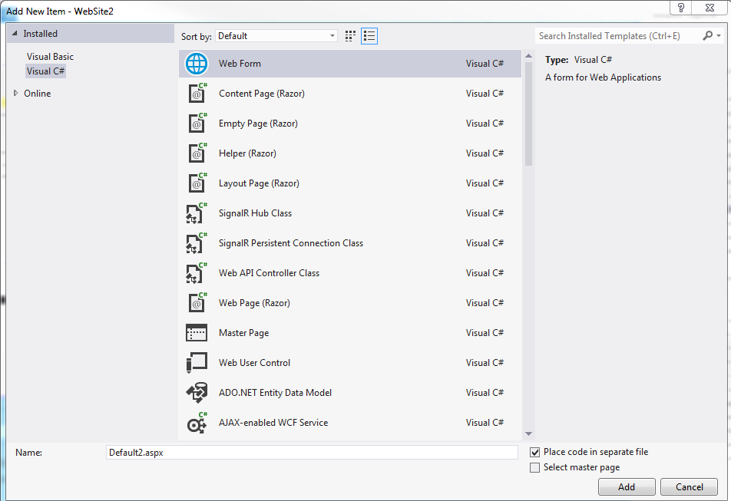
Adding a Web Form

Slide 13
The Web Form Editor
The Web Form editor allows you to
Create HTML5
Create ASP.NET server side tags
Create the “code behind” the form in a language such as Visual Basic or C#
The Web form editor has three views
Design / Split / Source

Slide 14
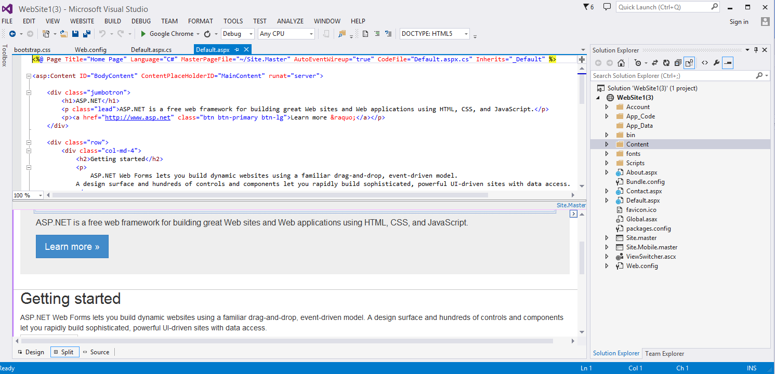
The Web Form Editor

Slide 15
Default Web Page Code (HTML)
A Web Form contains a @Page directive
More later but it’s this directive that makes the page a Web form
The remaining HTML should look familiar to you
Note there is exactly one <form> tag
ASP.NET controls must appear in the <form>

Slide 16
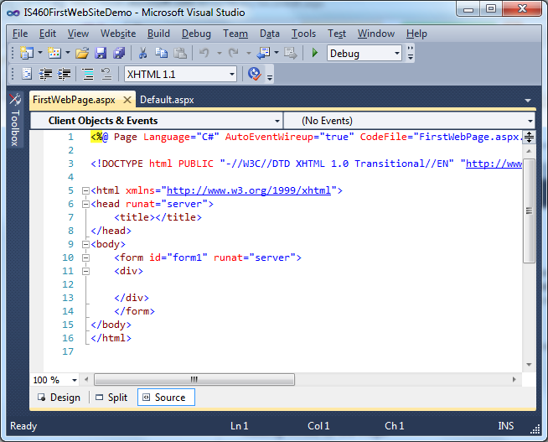
Default Web Page (HTML)

Slide 17
The Code Editor
An ASP.NET Web page is made up of two files
The .aspx file contains the HTML
The .aspx.cs file contains the VB or C# code
It works the same way as the Code Editor for desktop applications
The event names differ a bit
Page_Load instead of Form_Load for example

Slide 18
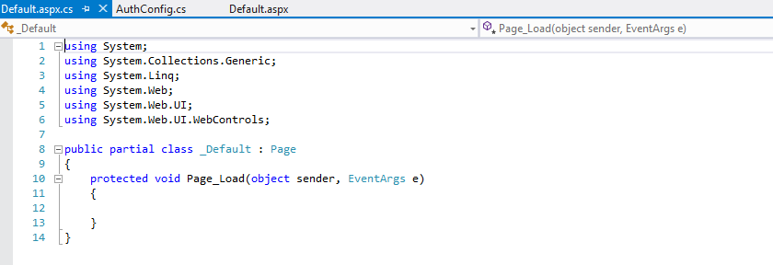
The Code Editor

Slide 19
Toolbox Controls
They are different controls than those used for desktop applications
HTML controls are standard HTML controls that will work with any browser
Other controls are server side controls that only work with IIS and ASP

Slide 20
Using Controls
Using the Toolbox, drag the desired control to the design surface
You can drag to the design surface or the HTML editor
Set properties using the Properties window
Create event handlers using the Properties window

Slide 21
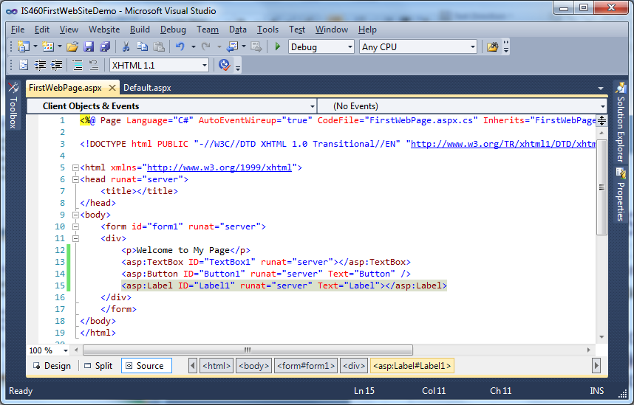
ASP.NET Controls
ASP controls have an <asp:> prefix. These are actually XML namespaces

Slide 22
Creating Event Handlers (1)
ASP.NET control events vary significantly from desktop events
There are no server side focus events (Why?)

Slide 23
Creating Event Handlers (2)
There are a couple of ways to do this
The easiest way is to select Design View
Then double-click the control to create the “default” event handler
Or use the event tab on the Properties window
Or create it by hand

Slide 24
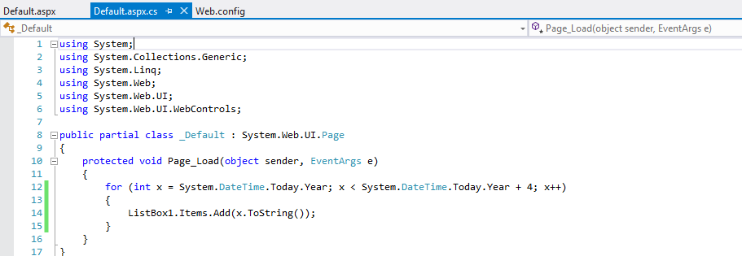
Event Handler Example

Slide 25
Page Inspector
On the server ASP writes HTML5 code
All of the ASP stuff is stripped away
Use the Page Inspector to see the emitted code
In the Solution Explorer, right click the Web Site and select View in Page Inspector

Slide 26
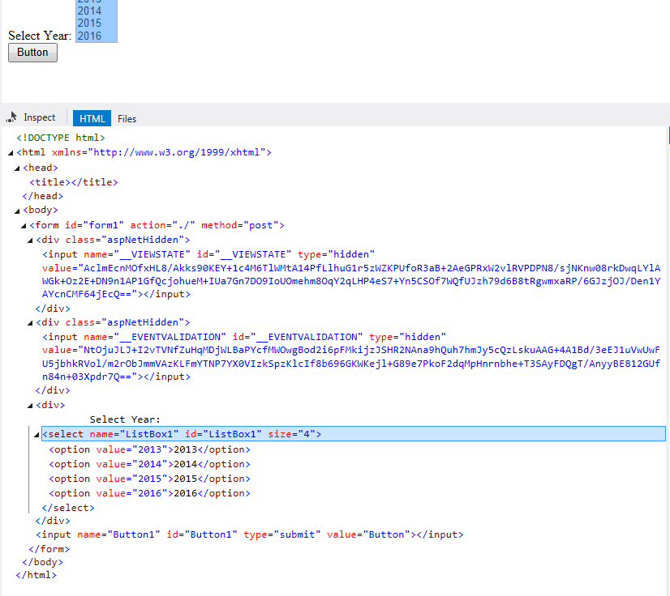
Page Inspector

Slide 27
Setting the Start Page
Every Web site has exactly one page designated as the start (default) page
To set the start page, right-click the page in the Solution Explorer
Click Set as Start Page

Slide 28
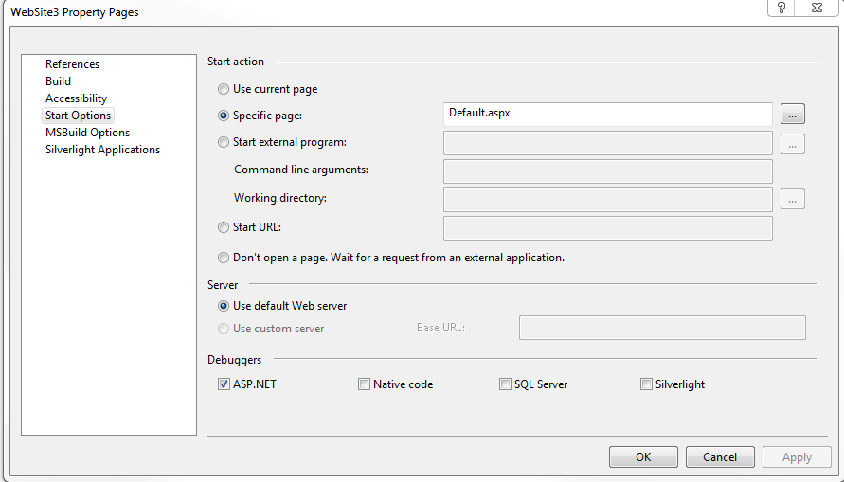
Setting the Start Page

Slide 29
Running the Application
It’s possible to run an ASP.NET application from Visual Studio
There is a “test” Web server built in
Just press F5 to run the application
It appears in the default Web browser
You will see a message to enable debugging when the application is run the first time

Slide 30
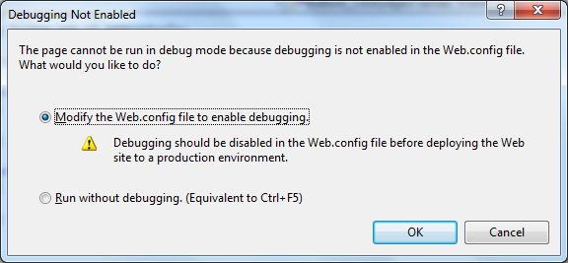
Running the Application

Slide 31
Debugging
Debugging windows work the same way in desktop and ASP.NET applications
Set breakpoints on executable code lines
Print values to the Immediate window
Use Watch windows to interrogate the values of variables
It’s possible to debug client-side Java script
Note that script debugging must be enabled

Slide 32
Introduction to Error Handling
Just like desktop applications, exceptions are thrown in various cases
Divide by 0, IO, Database, etc.
Unhandled, we call these the yellow page of death
What happens depends on the following Web.config setting:
<compilation debug="false">

Slide 33
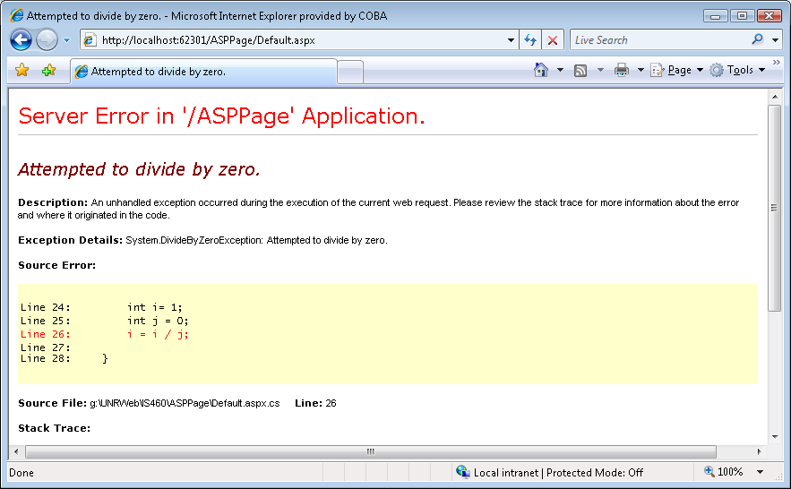
Error Message (Debug=true)

Slide 34
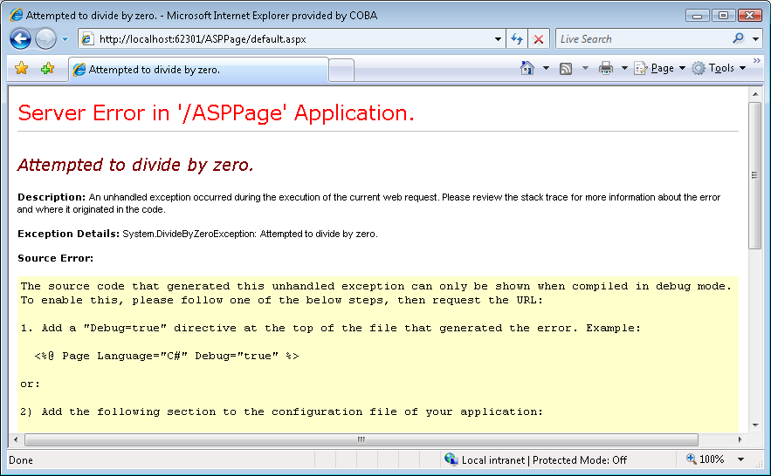
Error Message (Debug=false)

Slide 35
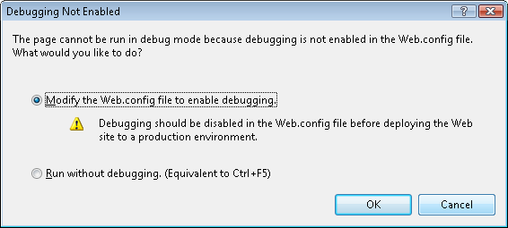
Error Message – Enabling Debugging

Slide 36
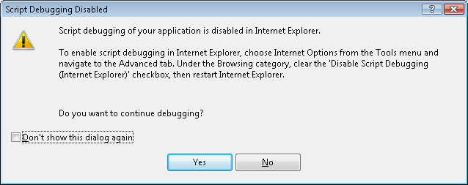
Error Message – Enabling Script Debugging

Slide 37
Handling Errors (Introduction)
Exception handlers are created (as usual) using try, catch blocks
The Page_Error event handler gives you a global exception handler for the page
The Application_Error event applies to the entire application itself

Slide 38
Handling Errors (Introduction)
Use Server.GetLastError() to get information about the most recent error
Use Server.ClearError() to clear the exception
Create other exception handlers, as necessary

Slide 39
Configuring Custom Errors
It’s all controlled by the customErrors section of the Web.config file
Attributes
defaultRedirect attribute causes a redirect to the specified page
Mode attribute enables / disables custom errors
On – Enables custom for remote and local hosts
Off – Disables custom errors
RemoteOnly – (default) Custom errors are displayed to the remote client

Slide 40
Configuring Custom Errors (Example)
<customErrors mode="On" defaultRedirect="GenericErrorPage.htm">
<error statusCode ="403" redirect="NoAccess.htm" />
<error statusCode="404" redirect="FileNotFound.htm" />
</customErrors>

Slide 41
Tracing (Introduction)
It’s possible to trace execution by enabling tracing in the Web.config file
@Page directives can also be used
Example
<trace enabled="true" pageOutput="true"/>

Slide 42
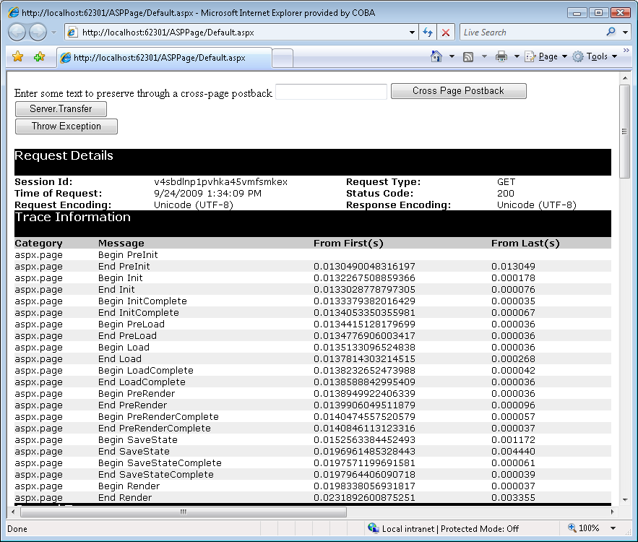
Tracing (Output)

Slide 43
Master and Content Pages
When the pages in a site should share a common theme
Master pages contain the reusable theme
The file is typically named site.master
Content pages appear in the master page
Much more later

